Slide 1
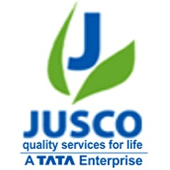
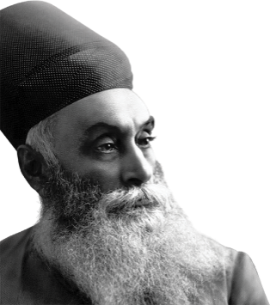

JAMSHEDPUR - SMART CITY
The Steel city transformation to a smart city …

Slide 2
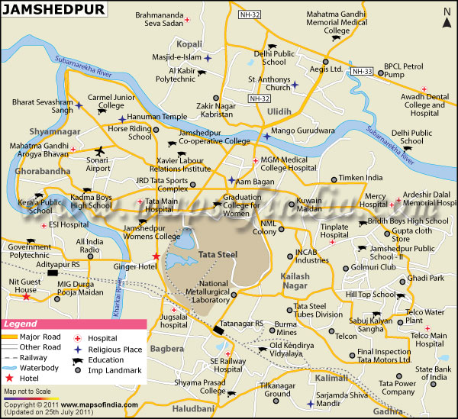

Slide 3
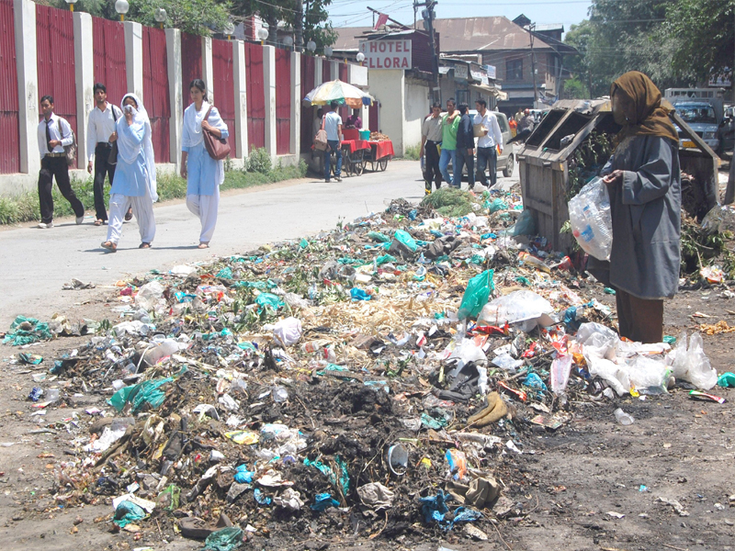
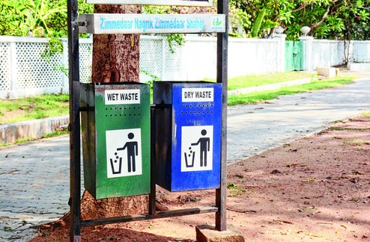
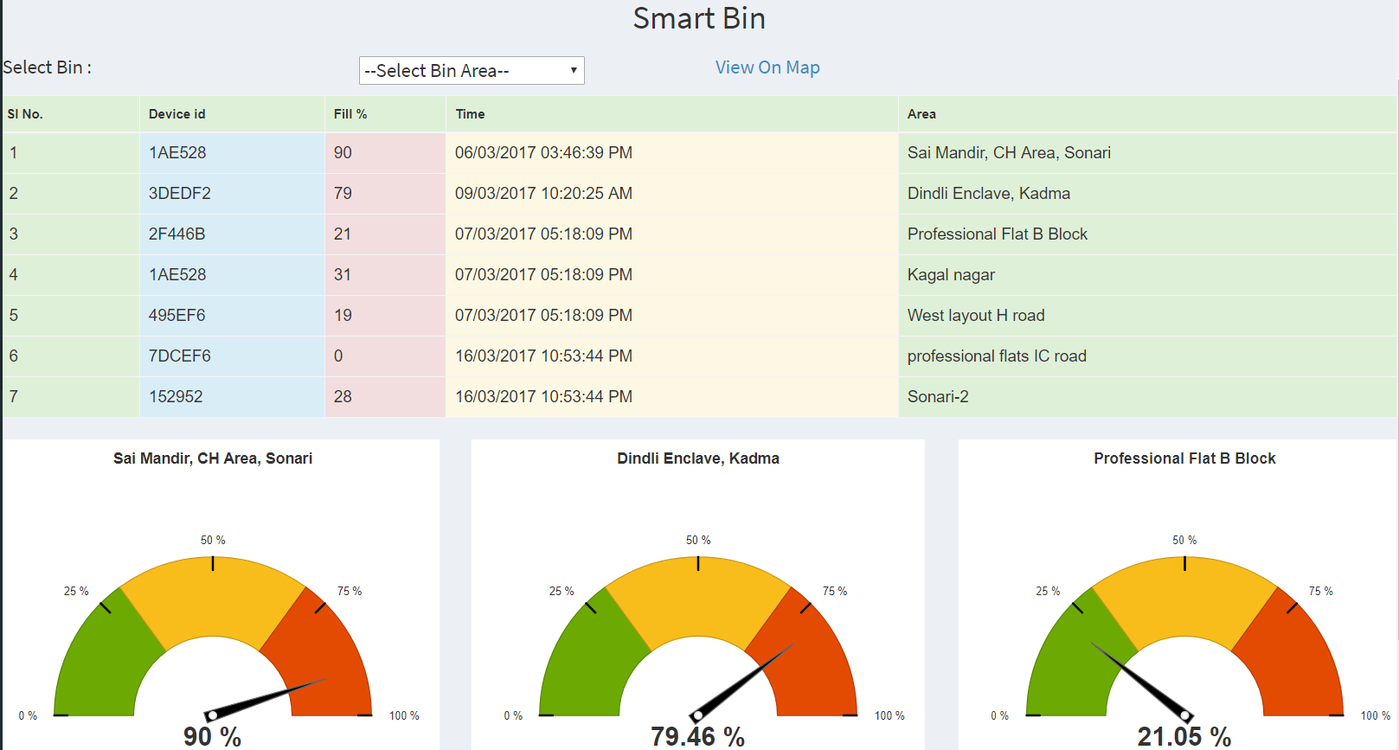
WASTE DISPOSAL
SMART BINS HAVE BEEN SET UP FOR PROPER DISPOSAL OF WASTE IN MAJOR AREAS OF JAMSHEDPUR

Slide 4
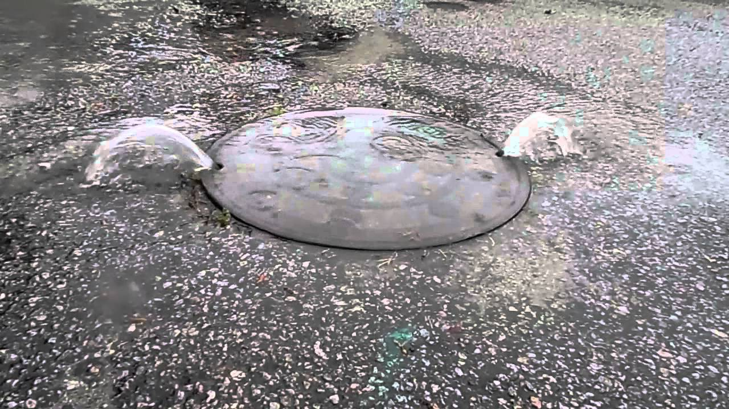
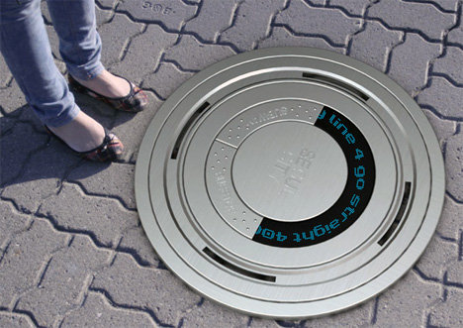
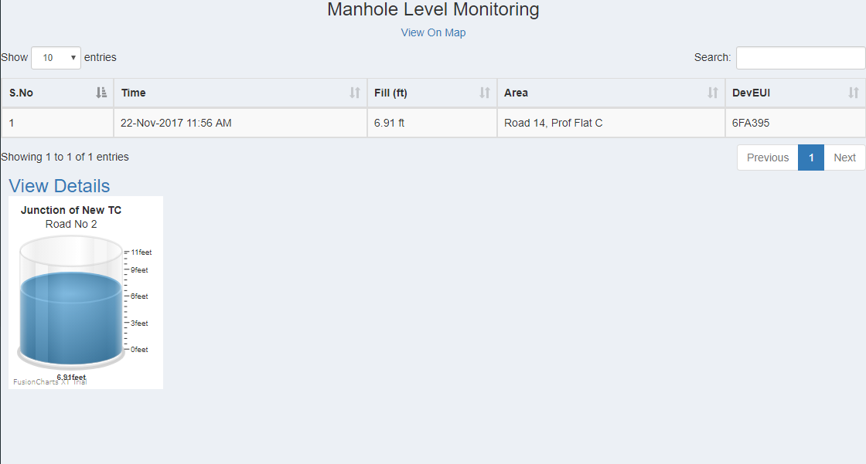
MANHOLE MANAGEMENT

Slide 5
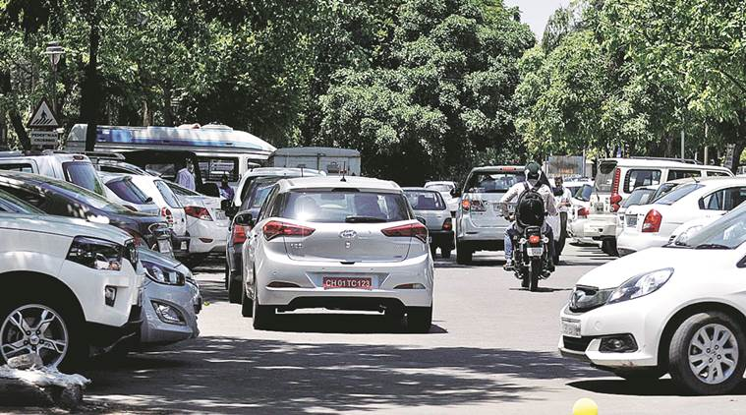
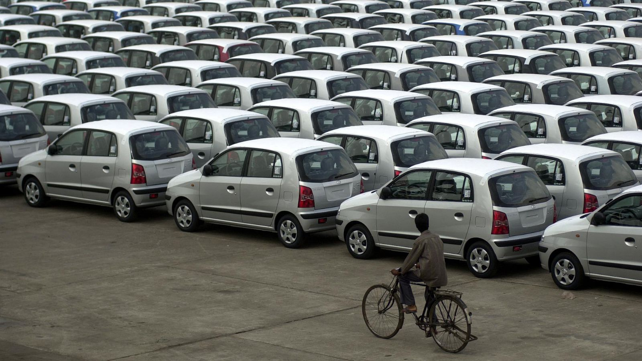
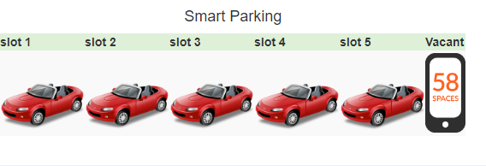
SMART PARKING

Slide 6
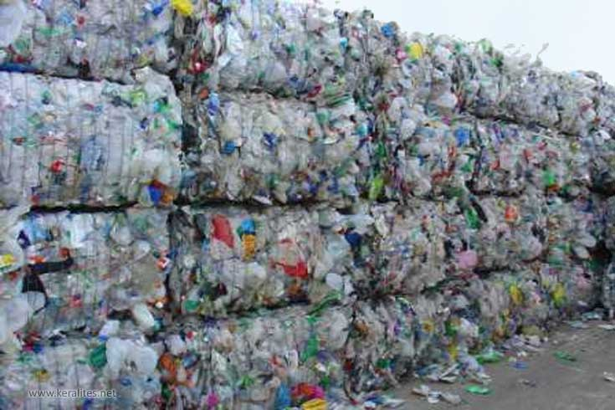
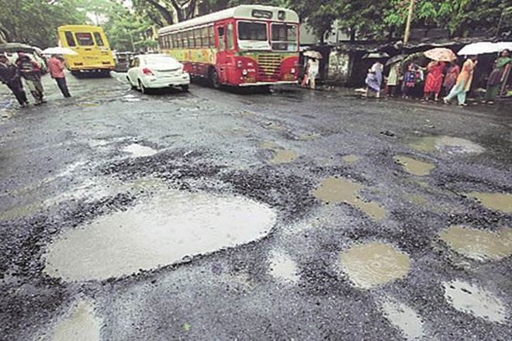
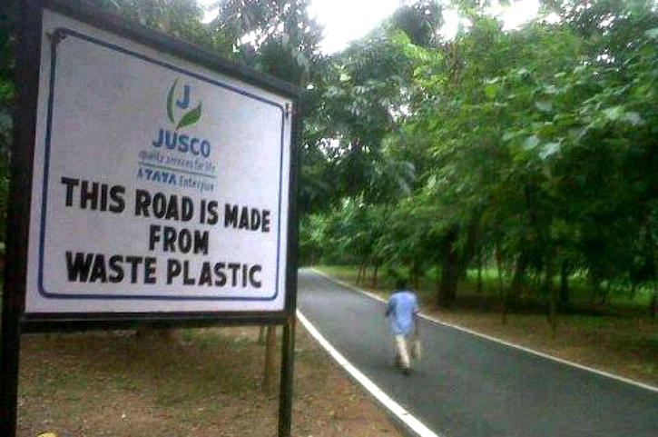
PLASTIC ROADS
Jamshedpur has set an example in recycling for the rest of the country by using plastic waste for road construction.
Plastic bottles, wrappers et al are collected from across the city and brought to 10 collection center's. The waste is then broken down by shredding it to 2mm to 4mm before processing it further.

Slide 7
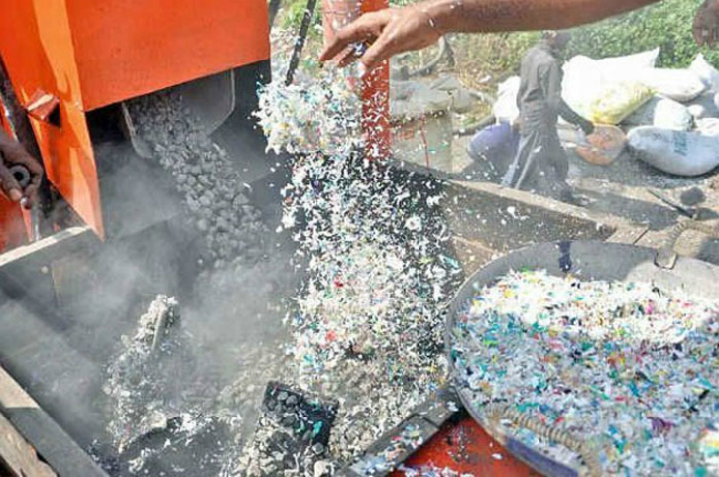
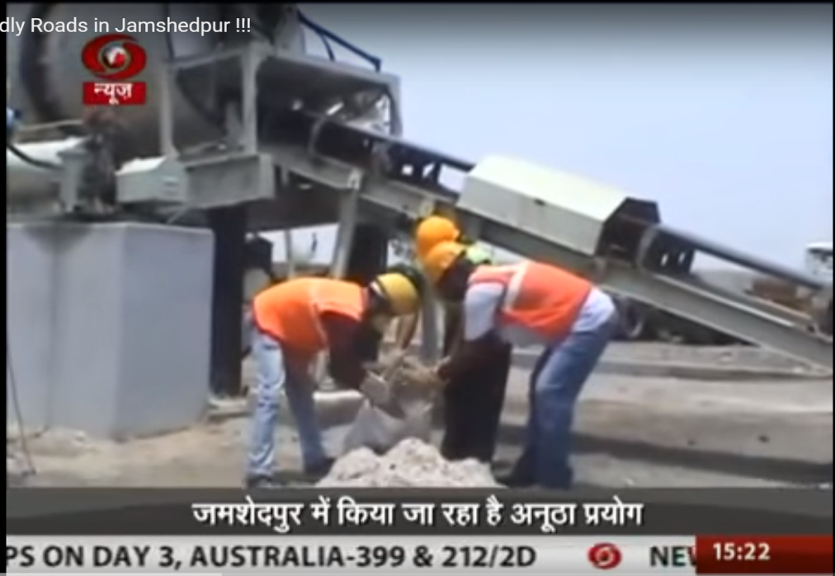
PLASTIC ROAD IMPLEMENTATION
Claiming that there is no maintenance cost involved for the first five years Gaurav Anand, Senior Manager (also an environment engineer) of JUSCO, said that for every stretch of such one km long and four meter wide road, one tonne of bitumen costing Rs 50,000 is saved.
The use of bitumen has been reduced by 7 per cent ever since JUSCO began using waste plastic in road construction work, he said, adding that the quality and longevity of roads made of waste plastic-aggregate-bitumen was two times better than bitumen road.

Slide 8
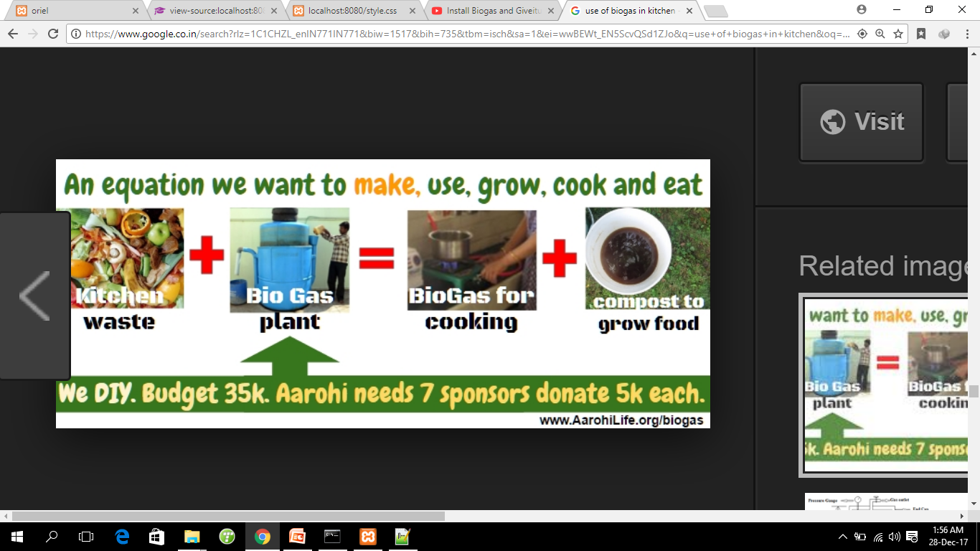
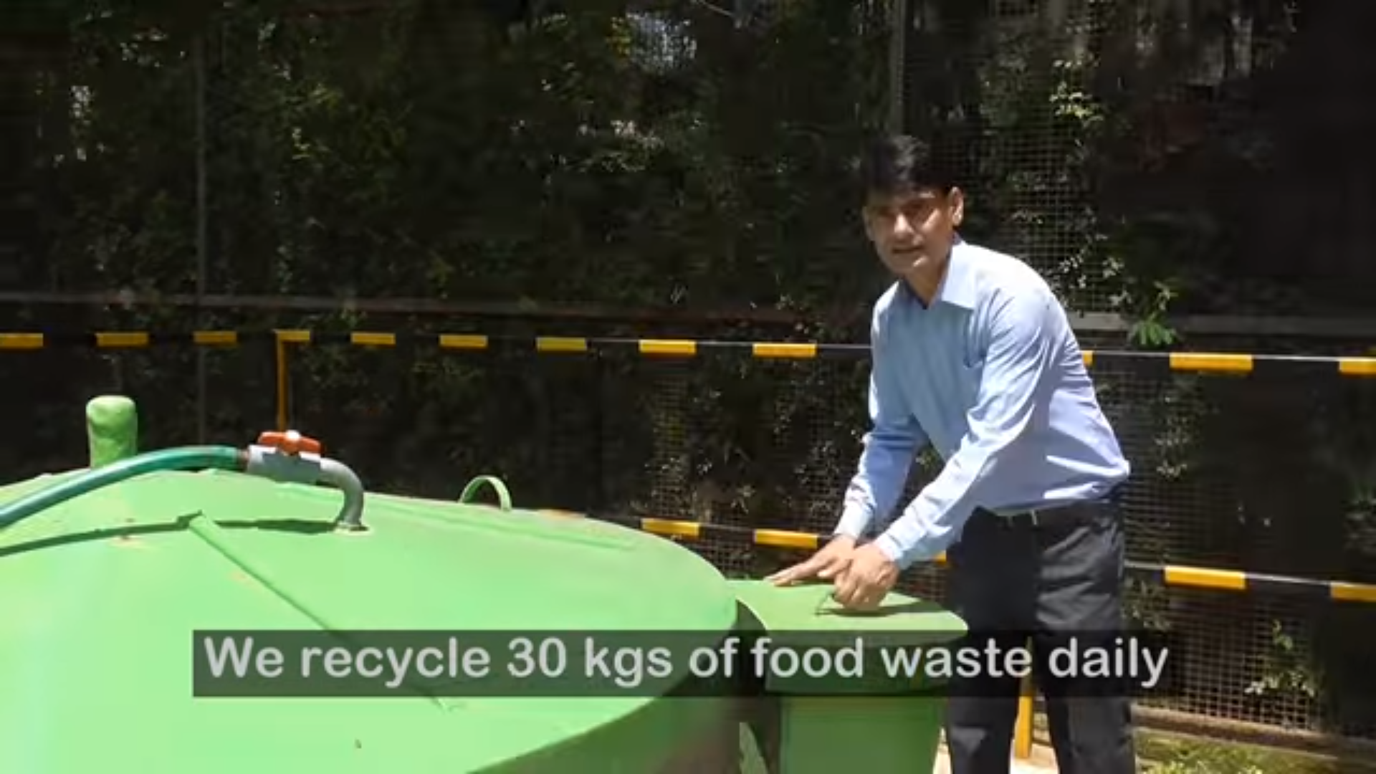
BIOGAS PLANT
Generate free gas
Initiative to encourage give it up

Slide 9
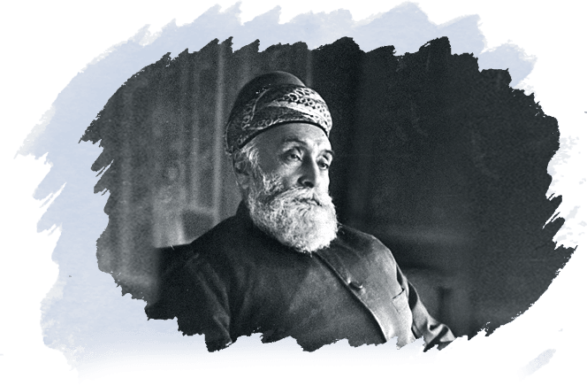
Rewarded Most Innovative Environmental Project Award 2017 by
GREENCO SUMMIT 2017

Slide 10
WATER TANK LEVEL ALERT

